Slide 1
CS440/520 Artificial Intelligence
Computer Science Department
Lecture 7:
Constraint Satisfaction Problems and
Logic-based Inference
23 September 2014
Instructor: Kostas Bekris

Slide 2
Constraint- Satisfaction Problems
Discrete and Finite Domains
E.g., map-Coloring, 8-queens puzzle
Boolean CSPs
Satisfiability problems (prototypical NP-Complete problem)
Discrete and Infinite Domains
Scheduling over the set of integers (e.g., all the days after today)
Continuous Domains
Scheduling over continuous time
Linear Programming problems
Constraints are linear inequalities over the variables
Additional examples:
crossword puzzles, cryptography problems, Sudoku
and many classical NP-Complete problems:
clique problems, vertex-cover, traveling salesman, subset-sum, hamiltonian-cycle

Slide 3
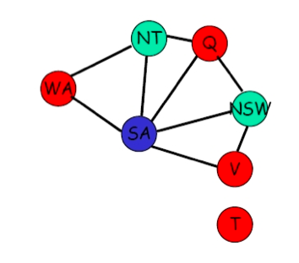

Example

Slide 4
Backtracking Search

Slide 5
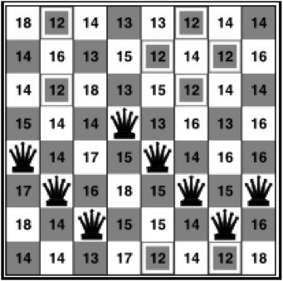

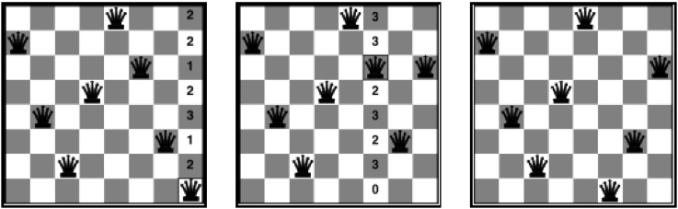
Local Search Approach

Slide 6
Backtracking: Forward Checking
 | WA | NT | Q | NSW | V | SA | T
Initially | RGB | RGB | RGB | RGB | RGB | RGB | RGB
After WA=R | R | G B | RGB | RGB | RGB | G B | RGB
After Q = G | R | B | G | R B | RGB | B | RGB
After V=B | R | B | G | R | B |  | RGB

Slide 7


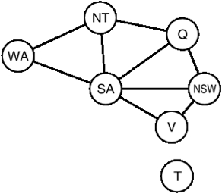



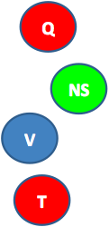

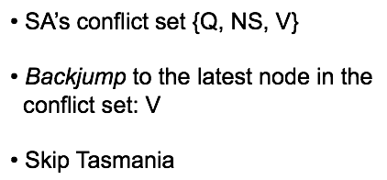
Backtracking: Intelligent Backjumping
Assume WA=red and NSW =red, then assign T, NT, Q, SA
SA will cause a conflict, whatever we do...
Where should the algorithm backjump?

Slide 8

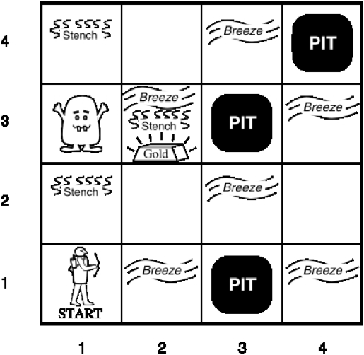






Binary CSP example: Wumpus World

Slide 9
Truth Tables
P | Q | ¬P | P∧Q | P∨Q | P⇒Q | P⇔Q
FALSE | FALSE | TRUE | FALSE | FALSE | TRUE | TRUE
FALSE | TRUE | TRUE | FALSE | TRUE | TRUE | FALSE
TRUE | FALSE | FALSE | FALSE | TRUE | FALSE | FALSE
TRUE | TRUE | FALSE | TRUE | TRUE | TRUE | TRUE

Slide 10
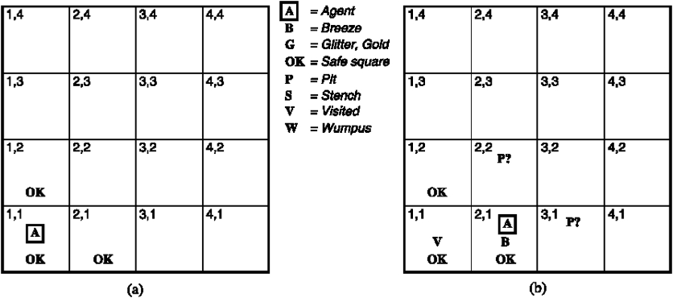
Wumpus World

Slide 11
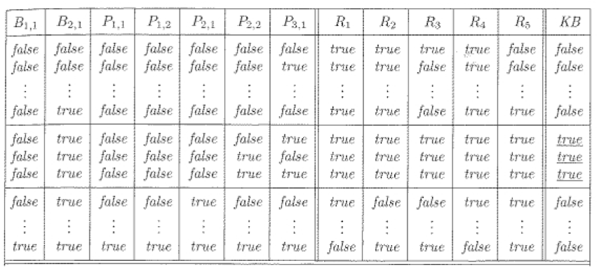
Truth Table for Wumpus World

Slide 12
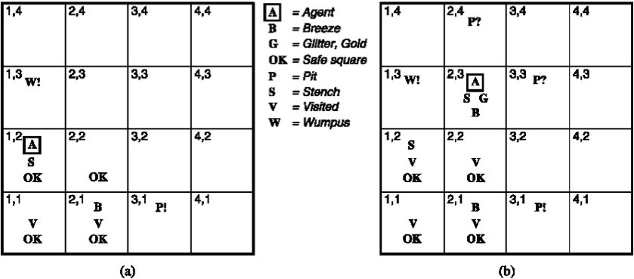
Wumpus World

Slide 13
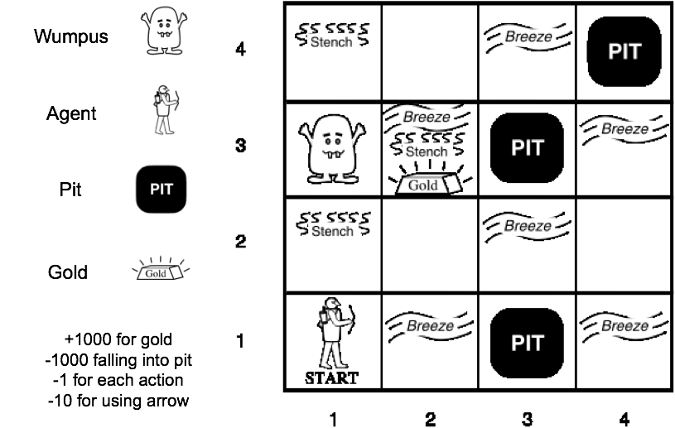
Wumpus World

